Slide 1
Splash Screen

Slide 2
Lesson Menu
Then/Now
New Vocabulary
Example 1: Square Roots of Negative Numbers
Example 2: Products of Pure Imaginary Numbers
Example 3: Equation with Pure Imaginary Solutions
Key Concept: Complex Numbers
Example 4: Equate Complex Numbers
Example 5: Add and Subtract Complex Numbers
Example 6: Real-World Example: Multiply Complex Numbers
Example 7: Divide Complex Numbers

Slide 3
Then/Now
You simplified square roots. (Prior Course).
Perform operations with pure imaginary numbers.
Perform operations with complex numbers.

Slide 4
Vocabulary
imaginary unit
pure imaginary number
complex number
complex conjugates

Slide 5
Example 1
Square Roots of Negative Numbers
A.
Answer:

Slide 6
Example 1
Square Roots of Negative Numbers
B.
Answer:

Slide 7
Example 1
A.
A.
B.
C.
D.
A
B
C
D

Slide 8
Example 1
B.
A.
B.
C.
D.
A
B
C
D

Slide 9
Example 2
Products of Pure Imaginary Numbers
A. Simplify –3i ● 2i.
–3i ● 2i = –6i ²
= –6(–1) i ² = –1
= 6
Answer: 6

Slide 10
Example 2
Products of Pure Imaginary Numbers
B.
Answer:

Slide 11
Example 2
A. Simplify 3i ● 5i.
A. 15
B. –15
C. 15i
D. –8
A
B
C
D

Slide 12
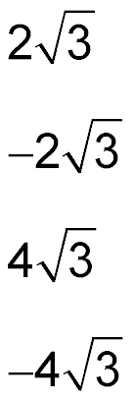
Example 2
B. Simplify .
A.
B.
C.
D.
A
B
C
D

Slide 13
Example 3
Equation with Pure Imaginary Solutions
Solve 5y ² + 20 = 0.
5y ² + 20 = 0 Original equation
5y ² = –20 Subtract 20 from each side.
y ² = –4 Divide each side by 5.
Take the square root of each side.
Answer: y = ±2i

Slide 14
Example 3
Solve 2x ² + 50 = 0.
A. ±5i
B. ±25i
C. ±5
D. ±25
A
B
C
D

Slide 15
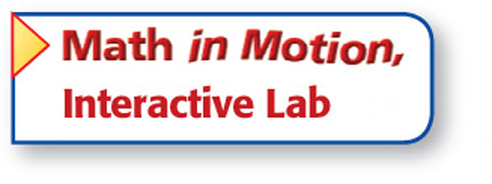
Concept

Slide 16
Example 4
Equate Complex Numbers
Find the values of x and y that make the equation 2x + yi = –14 – 3i true.
Set the real parts equal to each other and the imaginary parts equal to each other.
2x = –14 Real parts
x = –7 Divide each side by 2.
y = –3 Imaginary parts
Answer: x = –7, y = –3

Slide 17
Example 4
Find the values of x and y that make the equation 3x – yi = 15 + 2i true.
A. x = 15 y = 2
B. x = 5 y = 2
C. x = 15 y = –2
D. x = 5 y = –2
A
B
C
D

Slide 18
Example 5
Add and Subtract Complex Numbers
A. Simplify (3 + 5i) + (2 – 4i).
(3 + 5i) + (2 – 4i) = (3 + 2) + (5 – 4)i Commutative and Associative Properties
= 5 + i Simplify.
Answer: 5 + i

Slide 19
Example 5
Add and Subtract Complex Numbers
B. Simplify (4 – 6i) – (3 – 7i).
(4 – 6i) – (3 – 7i) = (4 – 3) + (–6 + 7)i Commutative and Associative Properties
= 1 + i Simplify.
Answer: 1 + i

Slide 20
Example 5
A. Simplify (2 + 6i) + (3 + 4i).
A. –1 + 2i
B. 8 + 7i
C. 6 + 12i
D. 5 + 10i
A
B
C
D

Slide 21
Example 5
B. Simplify (3 + 2i) – (–2 + 5i).
A. 1 + 7i
B. 5 – 3i
C. 5 + 8i
D. 1 – 3i
A
B
C
D

Slide 22
Example 6
Multiply Complex Numbers
ELECTRICITY In an AC circuit, the voltage E, current I, and impedance Z are related by the formula E = I ● Z. Find the voltage in a circuit with current 1 + 4j amps and impedance 3 – 6j ohms.
E = I ● Z Electricity formula
= (1 + 4j)(3 – 6j) I = 1 + 4j, Z = 3 – 6j
= 1(3) + 1(–6j) + 4j(3) + 4j(–6j) FOIL
= 3 – 6j + 12j – 24j ² Multiply.
= 3 + 6j – 24(–1) j ² = –1
= 27 + 6j Add.
Answer: The voltage is 27 + 6j volts.

Slide 23
Example 6
ELECTRICITY In an AC circuit, the voltage E, current I, and impedance Z are related by the formula E = I ● Z. Find the voltage in a circuit with current 1 – 3j amps and impedance 3 + 2j ohms.
A. 4 – j
B. 9 – 7j
C. –2 – 5j
D. 9 – j
A
B
C
D

Slide 24
Example 7
Divide Complex Numbers
A.
3 – 2i and 3 + 2i are conjugates.
Multiply.
i² = –1
a + bi form
Answer:

Slide 25
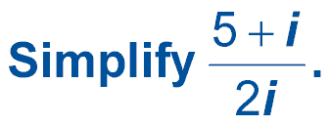
Example 7
Divide Complex Numbers
B.
Multiply by .
Multiply.
i² = –1
a + bi form
Answer:

Slide 26
Example 7
A.
A.
B. 3 + 3i
C. 1 + i
D.
A
B
C
D

Slide 27
Example 7
B.
A.
B.
C.
D.
A
B
C
D

Slide 28
End of the Lesson

